Slide 1
Basic Concepts (Part II)

Slide 2
Generic Code for ADT
In data structures we need to create generic code for ADTs
Generic code allows us to write one set of code and apply it to any data type
For example, we can write generic functions to implement a stack structure
We can then use the generic functions to implement an integer stack, a float stack, and so on
Two C tools that are required to implement an ADT
Pointer to void
Pointer to function

Slide 3
Pointer to void
Major programming languages are strongly typed. This means that operations such as assign and compare must use compatible types or be cast to compatible types.
The only exception is the pointer to void, which can be assigned without a cast.
This means that a pointer to void is a generic pointer that can be used to represent any data type.

Slide 4
Pointer to void
Important remark: a pointer to void cannot be dereferenced unless it is cast.
In other words, we cannot use *p without casting (without connection of the pointer with particular data type).

Slide 5
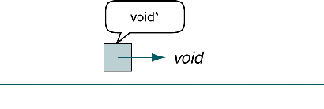
Pointer to void

Slide 6
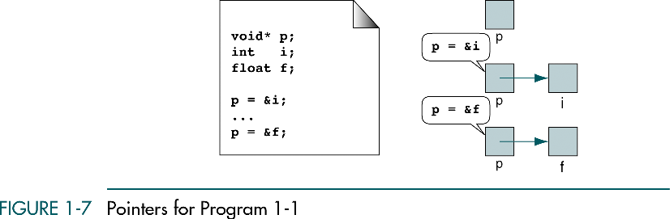
Pointer to void

Slide 7
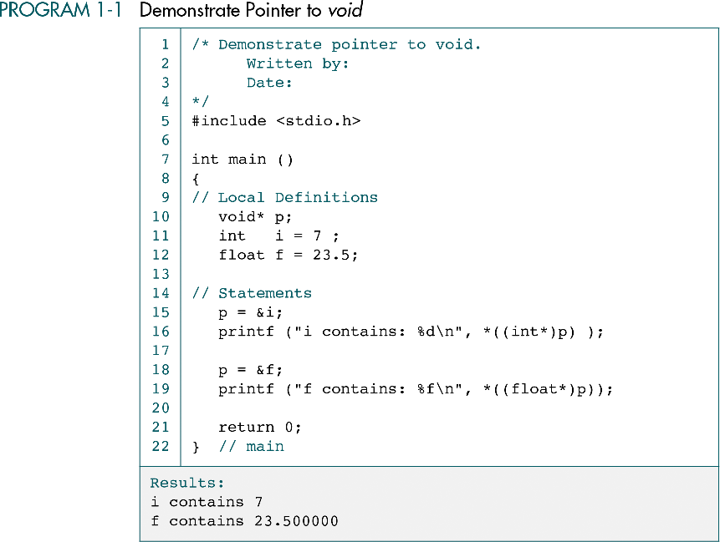

Slide 8
Function malloc
This function in C (a similar function is presented in all modern programming languages) returns a pointer to void.
This function is used to dynamically allocate any type of data.
This is a generic function that returns a pointer to void (void*). It can be used for returning a pointer to any data type. For example, a pointer to an integer can be created using
intPtr = (int*)malloc (sizeof (int))

Slide 9
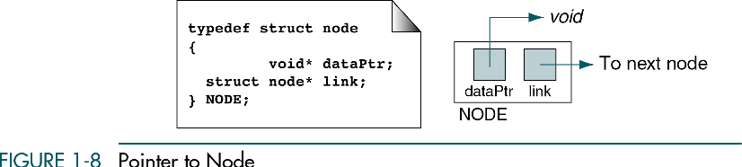
Pointer to node
A generic function to create a node structure
Two fields: data and link
The data field can be any type

Slide 10
P1-02.h

Slide 11
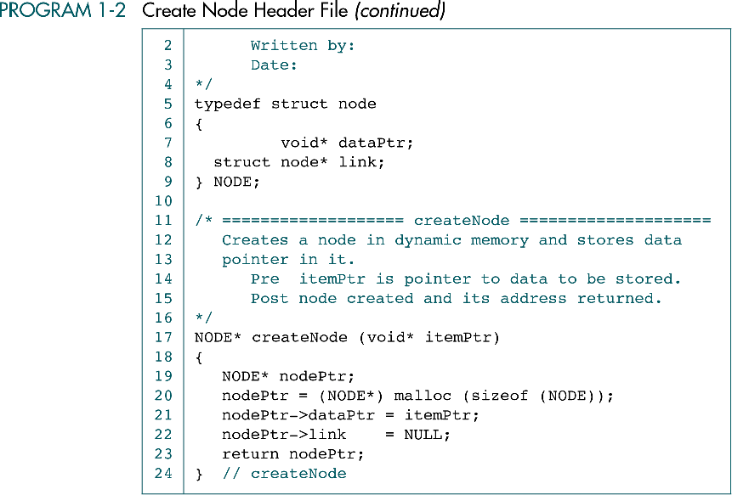

Slide 12
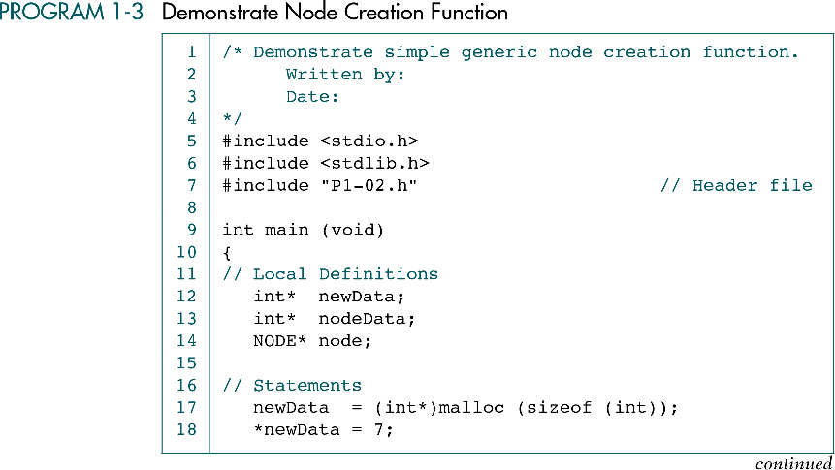

Slide 13
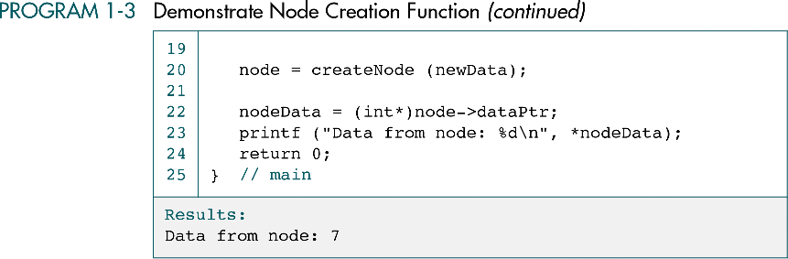

Slide 14
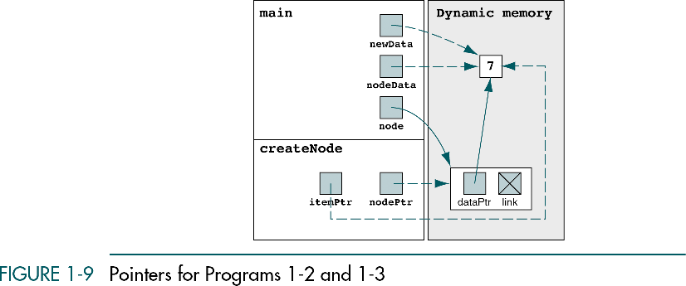

Slide 15
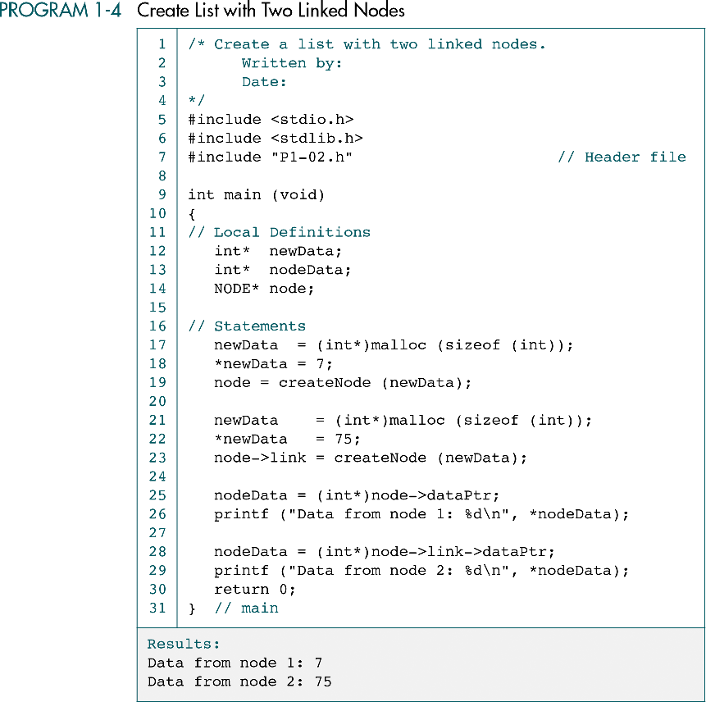

Slide 17
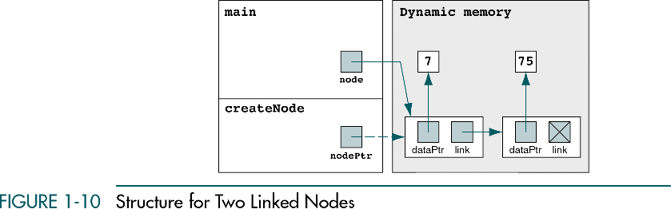

Slide 18
Pointer to function
Functions in your program occupy memory
The name of the function is a pointer constant to its first byte of memory
To declare a pointer to function, we code it as if it was a prototype definition, with the function pointer in parentheses.

Slide 19
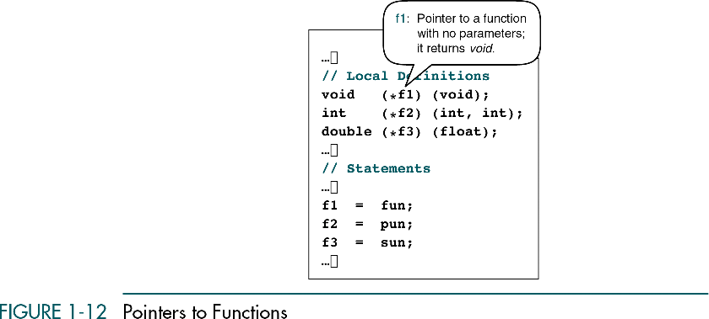
Functions (fun, pun, sun)

Slide 20
Example: function larger
This generic function will return a larger value of two values to be compared
To use a larger function as a generic one, we will need to write a compare function for each particular data type
A compare function will return either a positive or negative flag value depending on which value in a compared pair is larger: the first one or the second one.

Slide 21
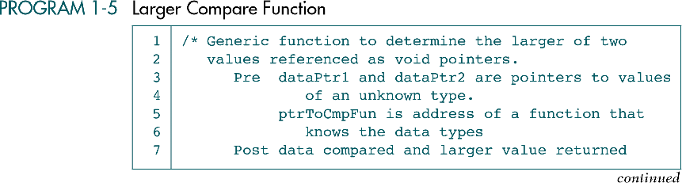
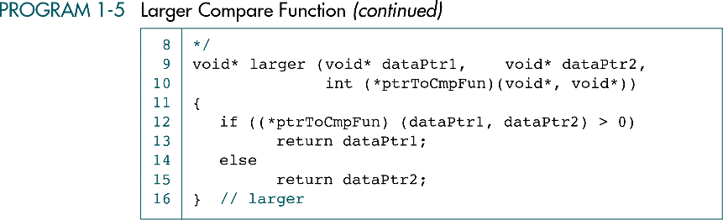
P1-05.h

Slide 22
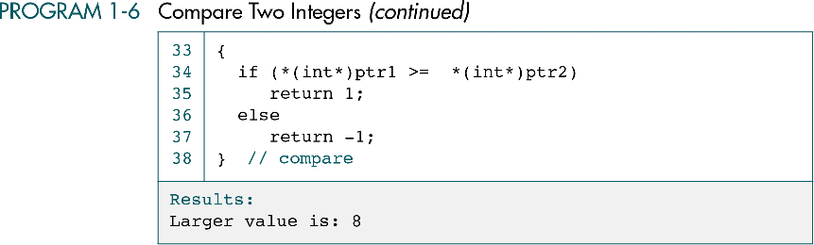
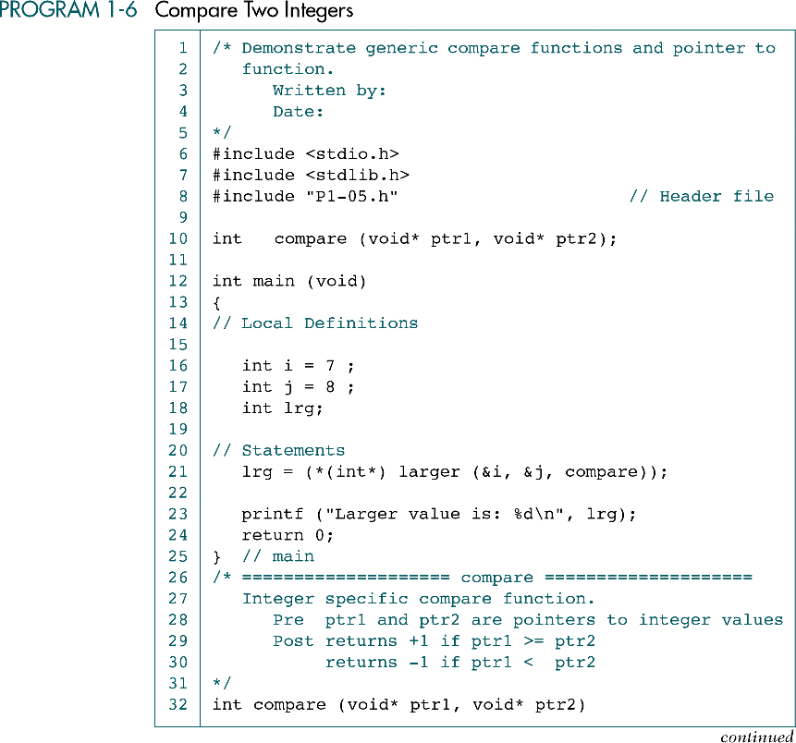

Slide 24
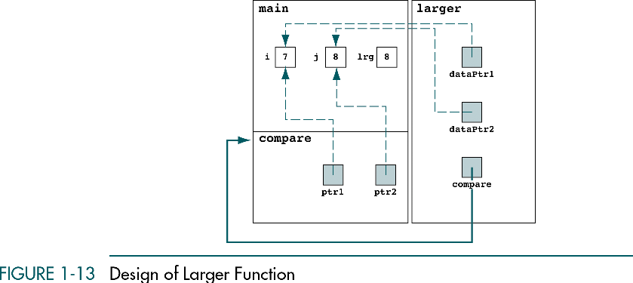

Slide 25
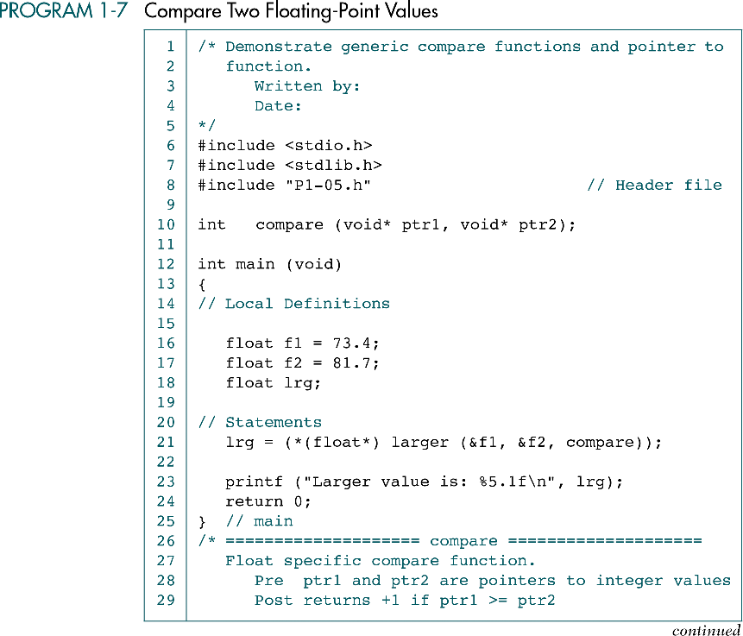

Slide 26
